Slide 1

Project Cyclistic: Data Analysis
Martin nforne
Last updated: Nov 23, 2022

Slide 2
Table of Content:
01 Statement of problem
02 Visualizations for data from Cyclistic (Nov, 2021 to Oct 2022), with slights to answer the above (the story thereof)
03 Conclusions
04 Top three (3) recommendations
05 Appendix

Slide 3
01 Statement of problem
Question to be answered: How do annual members and casual riders use Cyclistic bikes differently?
Cyclistic management and executives (stakeholders) intend to target casual users with a business campaign, intent on converting them to annual members.
But first, they want to know how annual members and casual riders use Cyclistic bikes differently.
The answer lies in the use data from Nov 2021 to present (Oct 2022), the past one year. The analysis of it is here presented as follows …

Slide 4
02 Presentation of Analysis
The visualizations that follow are for data from Cyclistic (Nov, 2021 to Oct 2022), with slights to answer the above question - the story thereof
The change log and analysis documentation can be accessed on GitHub here.

Slide 5
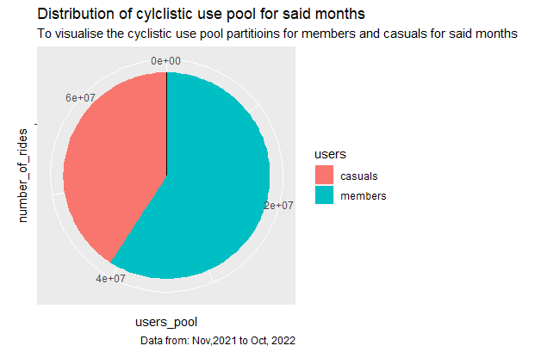
02 | Presentation of Analysis
In the passed twelve months, there were more member rides than there were casual rides

Slide 6
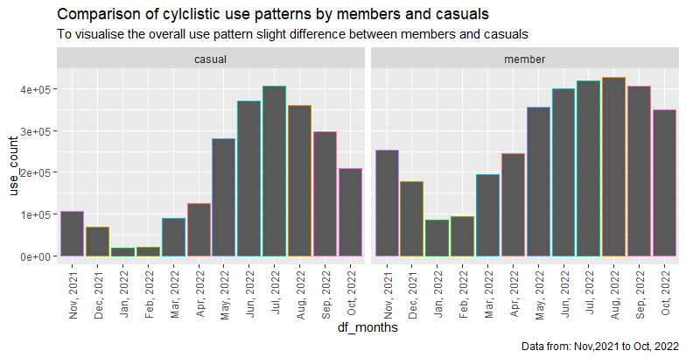
02 | Presentation of Analysis

Slide 7
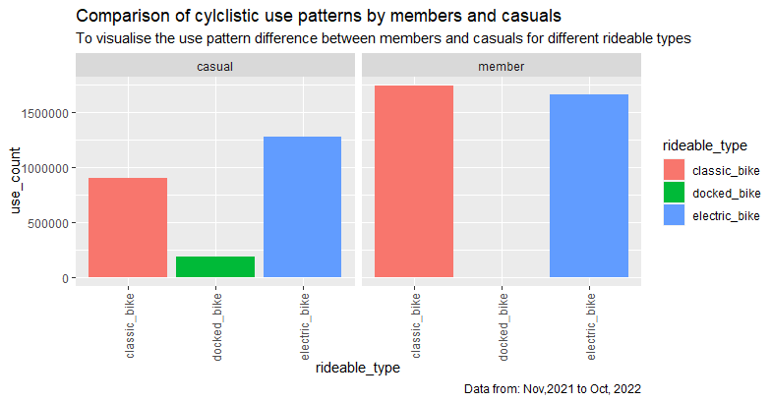
02 | Presentation of Analysis

Slide 8
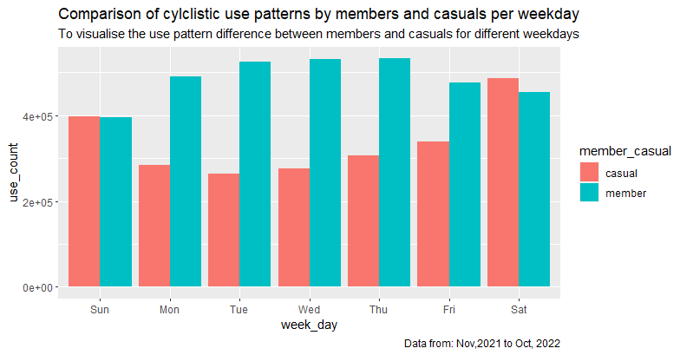
02 | Presentation of Analysis

Slide 9
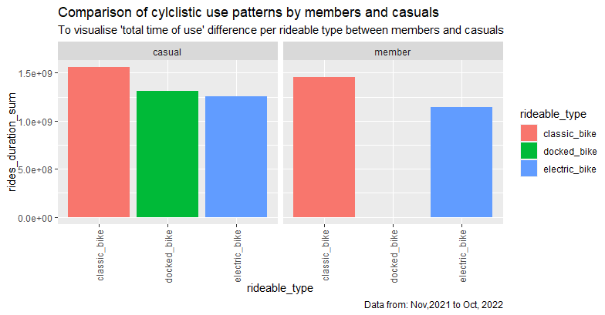
02 | Presentation of Analysis

Slide 10
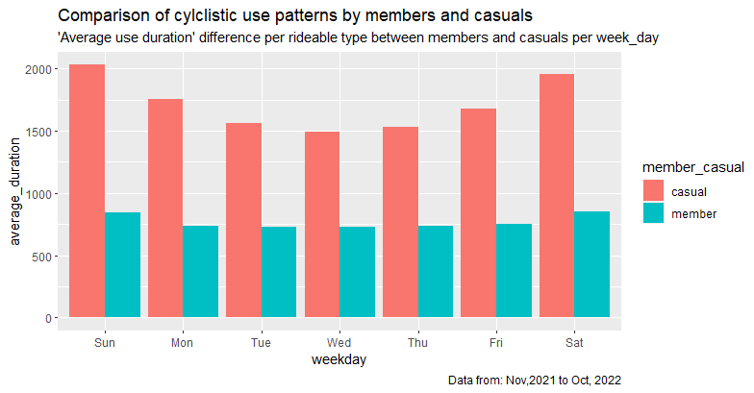
02 | Presentation of Analysis

Slide 11
03 Conclusions
From the visualizations on slides 5, 6 and 8, members ride more often than casuals.
From slides 7 and 9, the docked_bike is not a popular choice, least among members
Surprisingly, from slides 9 and 10, casuals put in more hours of use than members which could possibly mean they love it better.

Slide 12
04 Top three (3) recommendations
This was only a use history analysis. It takes more to make the well informed decision so I recommend taking a closer look at the rationale of casuals, so to approach them in the most productive way possible.
Since the docked_bike is not a popular choice and the classic_bike is most popular, even the more so with casuals, I recommend cutting back on investments in the former and investing in the latter.
Since casuals put in more use time than members, I recommend advertising to them the advantages of membership over casual use or better yet, approaching them with a limited membership discount period to attract them to signup.

Slide 13
05 Appendix
Data Source :
https://divvy-tripdata.s3.amazonaws.com/index.html
Offered to the public under the following license: https://ride.divvybikes.com/data-license-agreement
GitHub repository: https://github.com/nforne/project_cyclistic.git
Weblink: https://nforne.github.io/project_cyclistic/

